Slide 1
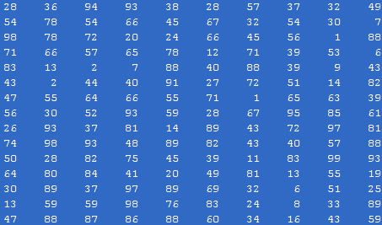

Correlation based TM
Goal: to find whether a specific known reference pattern resides within a given block of data.

Slide 2
Correlation based TM
Application: target detection, robot vision, video coding
Frame at time t
Frame at time t-1

Slide 3
Correlation based TM
Application: target detection, robot vision, video coding.
Frame at time t
Frame at time t-1
Pixel value:
Pixel value:

Slide 4
Correlation based TM
Application: target detection, robot vision, video coding.
Frame at time t
Frame at time t-1
Pixel value:
Pixel value:
Difference:

Slide 5
Correlation based TM
Application: target detection, robot vision, video coding.
Frame at time t
Frame at time t-1
Pixel value:
Pixel value:
Difference:
We need to encode only the difference

Slide 6
Correlation based TM
There are two basic steps in such a procedure:
Step 1: Move the reference pattern to all possible positions within the block of data. For each position, compute the “similarity” between the reference pattern and the respective part of the block of data.
Step 2: Compute the best matching value.

Slide 7
Correlation based TM
There are two basic steps in such a procedure:
Step 1: Move the reference pattern to all possible positions within the block of data. For each position, compute the “similarity” between the reference pattern and the respective part of the block of data.
Step 2: Compute the best matching value.

Slide 8
Correlation based TM
There are two basic steps in such a procedure:
Step 1: Move the reference pattern to all possible positions within the block of data. For each position, compute the “similarity” between the reference pattern and the respective part of the block of data.
Step 2: Compute the best matching value.

Slide 9
Correlation In Image Matching
Application to images: Given a reference image, r(i, j) of M×N size, and an I×J image array t(i, j). Move r(i, j) to all possible positions (m, n) within t(i, j).
J
N
M
I
Reference, r
Test, t

Slide 10

Correlation In Image Matching
Compute the distance:
for every (m,n)
For all (m, n), compute the minimum.

Slide 11
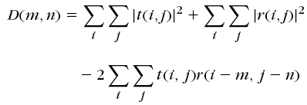
Correlation In Image Matching
The equation
can be written as

Slide 12
Correlation In Image Matching
In the equation
shaded terms are assumed constant
provided pixel levels do not change much across the test image

Slide 13

Correlation In Image Matching
Canceling out the shaded terms, find point (m, n) that maximize:

Slide 14
Correlation In Image Matching
c (m, n) is no longer a difference term
This is called cross correlation

Slide 15

Correlation In Image Matching
In case gray level variation is valid, normalize:

Slide 16
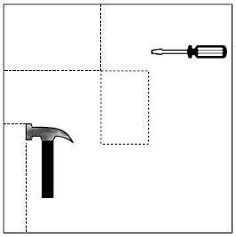

Correlation In Image Matching
Example:
Reference, r
Test Image, t

Slide 17
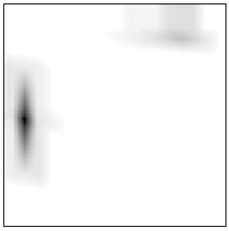
Correlation In Image Matching
Example:
Reference, r
Test Image, t
Correlation Image

Slide 18
Computation Considerations in Correlation Based TM (1)
Find c (m,n) at every pixel
This equation looks like convolution operation
Alternate is to calculate in the frequency domain

Slide 19
Computation Considerations in Correlation Based TM (1)
The frequency domain representation of
is

Slide 20
Computation Considerations in Correlation Based TM (2)
Limit the search space
Search only in the area of [-p, p] X [-p, p] centered at (x, y)
r

Slide 21
Computation Considerations in Correlation Based TM (2)
Limit the search space
Search only in the area of [-p, p] X [-p, p] centered at (x, y)
r

Slide 22
Computation Considerations in Correlation Based TM (2)
Limit the search space
Search only in the area of [-p, p] X [-p, p] centered at (x, y)
r
(x, y)
(x + p, y + p)

Slide 23
Computation Considerations in Correlation Based TM (2)
Limit the search space
Search only in the area of [-p, p] X [-p, p] centered at (x, y)
r
(x, y)
(x - p, y - p)

Slide 24
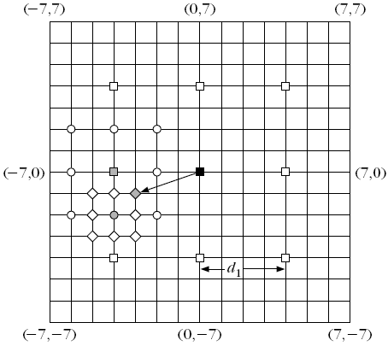
Computation Considerations in Correlation Based TM (3)
2D Logarithmic search
Start with a rectangle of size [-p, p] X [-p, p]

Slide 25
Computation Considerations in Correlation Based TM (3)
2D Logarithmic search
Search only at 9 points separated by d₁

Slide 26
Computation Considerations in Correlation Based TM (3)
2D Logarithmic search
Maximum found at dark red

Slide 27
Computation Considerations in Correlation Based TM (3)
2D Logarithmic search
Search in the rectangle of size [-p/4, p/4] X [-p/4, p/4] centered at dark red

Slide 28
Computation Considerations in Correlation Based TM (3)
2D Logarithmic search
Maximum found at green

Slide 29
Computation Considerations in Correlation Based TM (3)
2D Logarithmic search
Search in the rectangle of size [-p/8, p/8] X [-p/8, p/8] centered at green

Slide 30
Computation Considerations in Correlation Based TM (3)
2D Logarithmic search
Maximum found at blue

Slide 31
Computation Considerations in Correlation Based TM (3)
Complexity MN(8k+1)

Slide 32
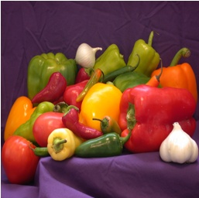

Computation Considerations in Correlation Based TM (4)
Hierarchical Search
Search the reference in the area of size [-p, p] X [-p, p] centered at (x, y)
Let, reference be of size 16X16
reference
test

Slide 33


Computation Considerations in Correlation Based TM (4)
Hierarchical Search
Level 0
Low pass Filter of Level 0
Original reference and test image

Slide 34


Computation Considerations in Correlation Based TM (4)
Hierarchical Search
Sub-sampled by 2
Level 0
Low pass Filter of Level 0
Level 1

Slide 35



Computation Considerations in Correlation Based TM (4)
Hierarchical Search
Level 1
Low pass Filter of Level 1
Sub-sampled by 2
Level 2

Slide 36
Computation Considerations in Correlation Based TM (4)
Hierarchical Search
. . . .
Level 0
Level 1
Level 2

Slide 37
Computation Considerations in Correlation Based TM (4)
Hierarchical Search

Slide 38
Computation Considerations in Correlation Based TM (4)
Hierarchical Search
2p
2p
(x, y)

Slide 39
Computation Considerations in Correlation Based TM (4)
Hierarchical Search
p/2
p
2p
(x/2, y/2)
(x/4 y/4
(x, y)
Level 0
Level 1
Level 2

Slide 40
Computation Considerations in Correlation Based TM (4)
Hierarchical Search
Start at Level 2 with the reference of size 4X4
Search in the rectangle [-p/4, p/4] [-p/4, p/4] centered at (x/4, y/4)

Slide 41
Computation Considerations in Correlation Based TM (4)
Hierarchical Search
Start at Level 2 with the reference of size 4X4
Search in the rectangle [-p/4, p/4] [-p/4, p/4] centered at (x/4, y/4)
Let optimal found at (x₁, y₁) with respect to (x/4, y/4).

Slide 42
Computation Considerations in Correlation Based TM (4)
Hierarchical Search
At Level 1, with the reference of size 8X8
Search in the rectangle [-1, 1] X [-1, 1]
centered at (x/2 +2x₁, y/2+2y₁)

Slide 43
Computation Considerations in Correlation Based TM (4)
Hierarchical Search
At Level 1, with the reference of size 8X8
Search in the rectangle [-1, 1] X [-1, 1]
centered at (x/2 +2x₁, y/2+2y₁)
Let optimal found at (x₂, y₂) with respect to (x/2, y/2).

Slide 44
Computation Considerations in Correlation Based TM (4)
Hierarchical Search
At Level 0, with the reference of size 16X16
Search in the rectangle [-1, 1] X [-1, 1]
centered at (x +2x₂, y+2y₂)

Slide 45
Computation Considerations in Correlation Based TM (4)
Hierarchical Search
At Level 0, with the reference of size 16X16
Search in the rectangle [-1, 1] X [-1, 1]
centered at (x +2x₂, y+2y₂)
Location at this time is the final one

Slide 46
Computation Considerations in Correlation Based TM (4)
Complexity of Hierarchical Search
9 × No. of Decompositions + Complexity at highest level

